Slide 1

Movie matchmaker
Kami Whithurst-Levy
Theodore Moreland
Adam Feldstein
Danielle Perkins

Slide 2
Business Objectives:
Recommend movies to user based on their basic movie preferences
New user inputs 3 random movies they like
Filter through movie database to narrow down recommendations
Potential use cases
Applications & websites for users (i.e movies, e-books, games)
Products & Sales websites (clothing, health & skin care products, nutrition and food)

Slide 3






Technologies Used:
Splinter: web scraping
Pandas & pgAdmin: data wrangling
PostgreSQL & S3 Bucket: movie database and image storage
Scikitlearn, Scipy, and Joblib, Fuzzy Wuzzy: machine learning
Flask: backend
Javascript, Bootstrap, HTML/CSS, jQuery: frontend/display
AWS: host website
This Photo by Unknown Author is licensed under CC BY-SA

Slide 4
Data and Clean up:
Extraction
Data source: MovieLens
Reviews from 1995-2008
Original Dataset: CSV containing 27.7 million rows of ratings scrapped from MovieLens subscribers
Transformation
Filtered to include only movies reviewed 75x or more leaving us with 26.8 million reviews
282,000 reviewers
8,000+ movies
Loading
PostgreSQL database
Two tables: large, filtered dataset & list of TMDB i.d.s and IMDB i.d.s

Slide 5
Application Layout:
Create wireframe for the website
Used Python to web scrape 8000+ movie posters
Used AWS s3 to store posters
Flask then serves movie information from database to the client
-Users select movies, javascript then passes that data to Flask and ML model
-Flask then sends recommended movies to client and HTML where user can view recommendations and posters

Slide 6
Machine Learning:

Slide 7
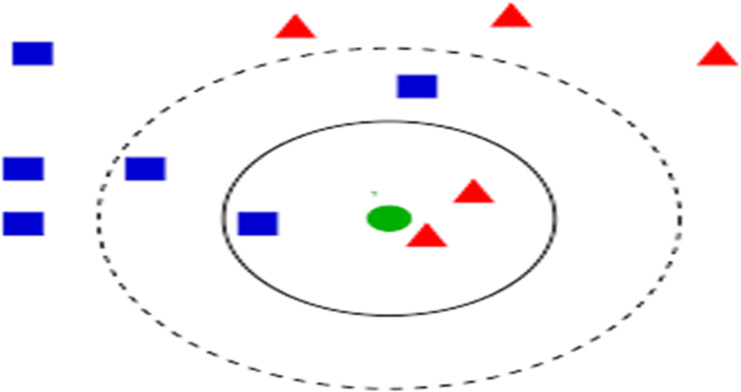

Slide 8
Future Work:
Add movie details
Upon hover, include movie description, actors, producer
Expand website options to render other results
We focused on movies but we could apply this same approach to recommend books and games
Include filters on recommendations
Filter down movies by genre, production year/decade, featured actor/actress, rating

Slide 9
Thank you
Questions?

